Slide 1
Chapter 8
Algorithms

Slide 2
OBJECTIVES
After reading this chapter, the reader should
be able to:
Understand the concept of an algorithm.
Define and use the three constructs for developing
algorithms: sequence, decision, and repetition.
Understand and use three tools to represent algorithms:
flowchart, pseudocode, and structure chart.
Understand the concept of modularity and subalgorithms.
List and comprehend common algorithms.

Slide 3
Contents
8.1 Concept
8.2 Three Constructs
8.3 Algorithm representation
8.4 More Formal Definition
8.5 Subalgorithms
8.6 Basic Algorithms
8.7 Recursion
Summary

Slide 4
8.1
CONCEPT

Slide 5
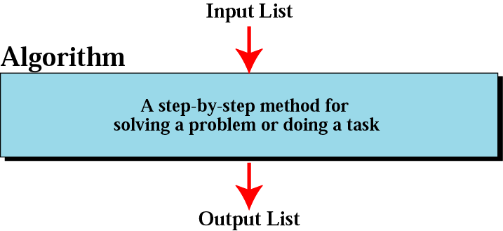
Figure 8-1
Informal definition of an algorithm
used in a computer

Slide 6
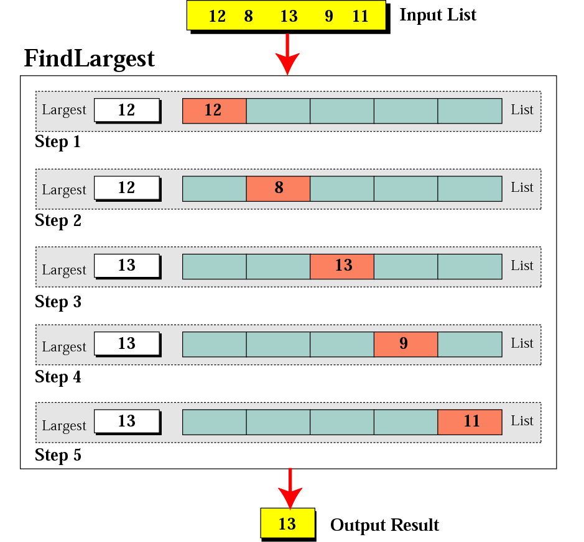
Example
Finding the largest integer among five integers
Figure 8-2

Slide 7
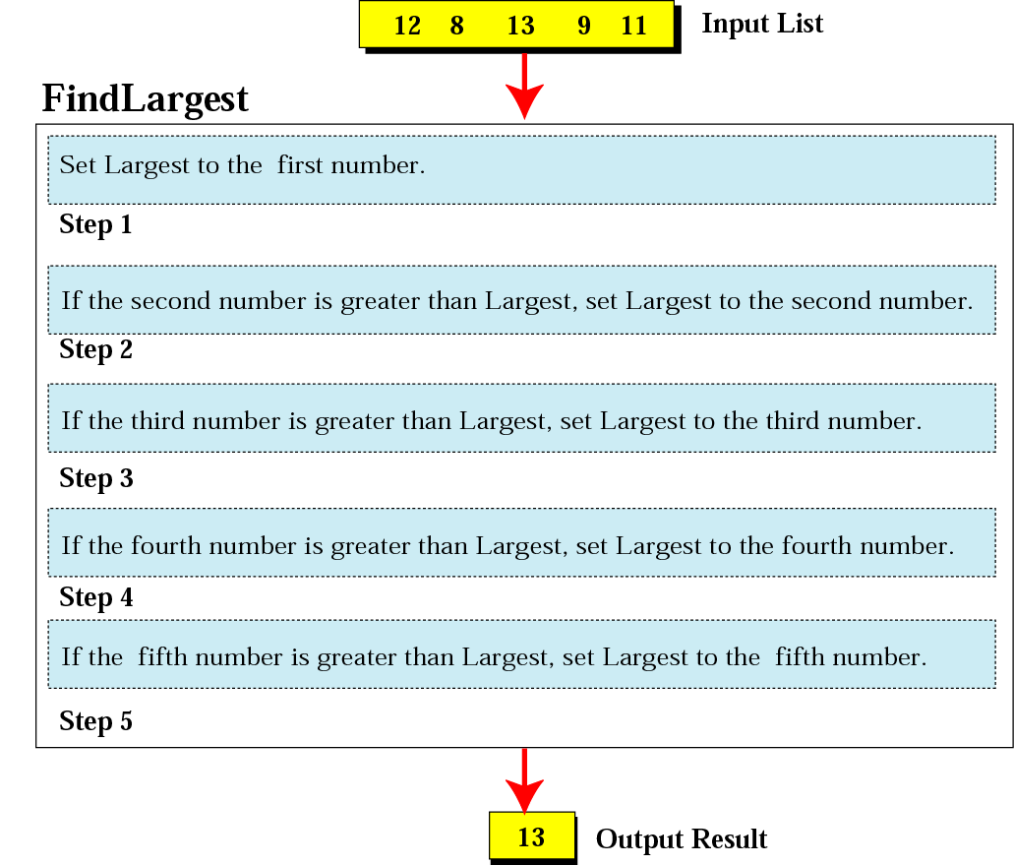
Figure 8-3
Defining actions in FindLargest algorithm

Slide 8
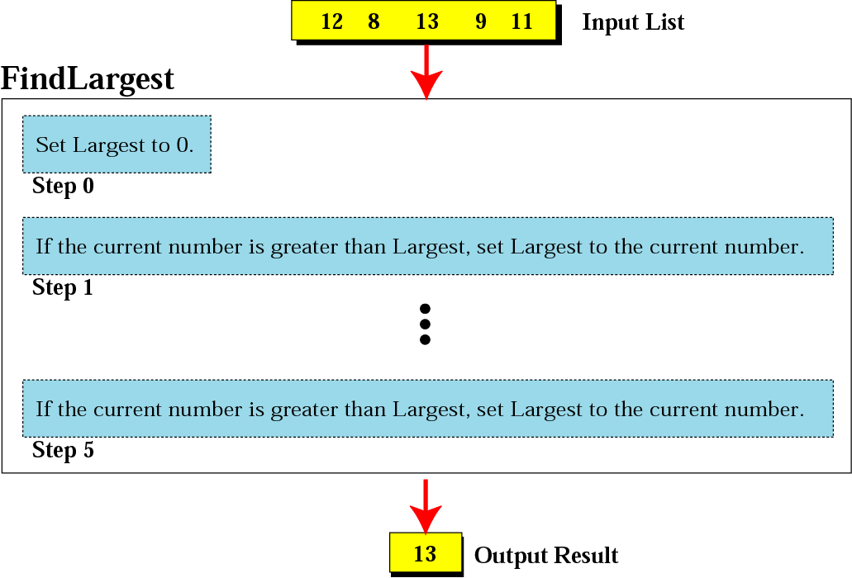
Figure 8-4
FindLargest refined

Slide 9
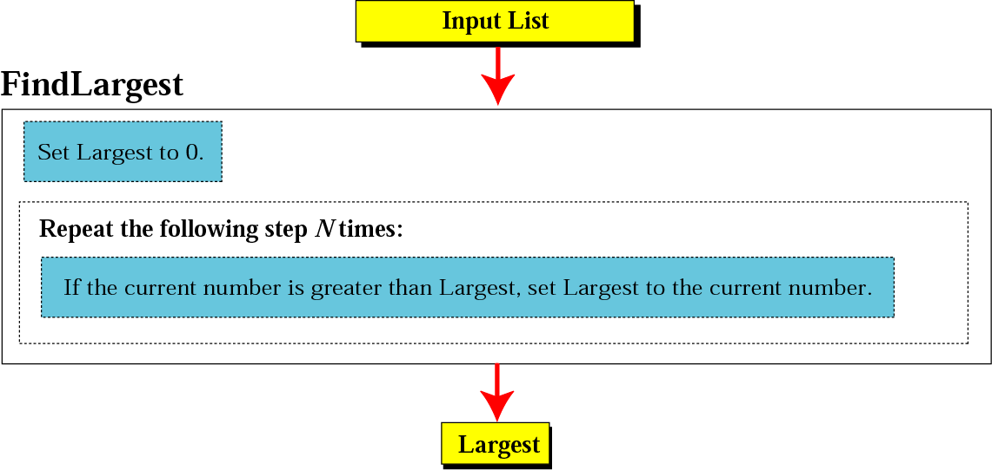
Figure 8-5
Generalization of FindLargest

Slide 10
8.2
THREE CONSTRUCTS
for a structured program or algorithm

Slide 11
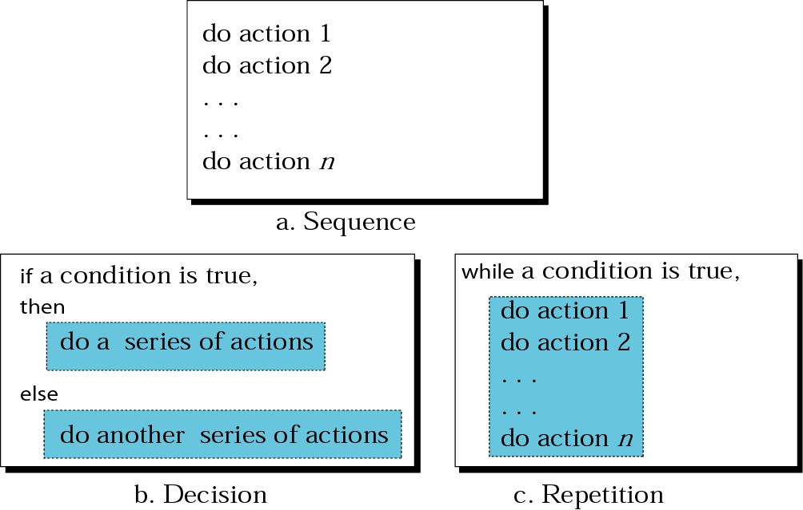
Figure 8-6
Three constructs

Slide 12
8.3
ALGORITHM REPRESENTATION
---Flowchart, Pseudocode

Slide 13
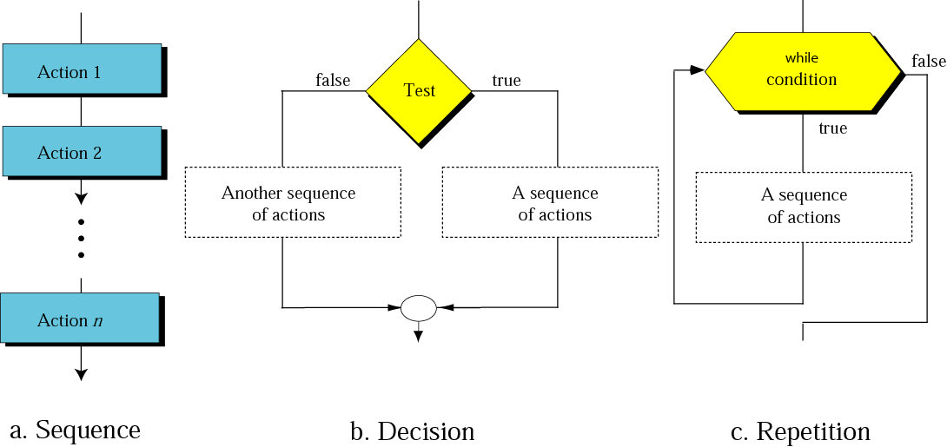
Figure 8-7
Flowcharts for three constructs

Slide 14
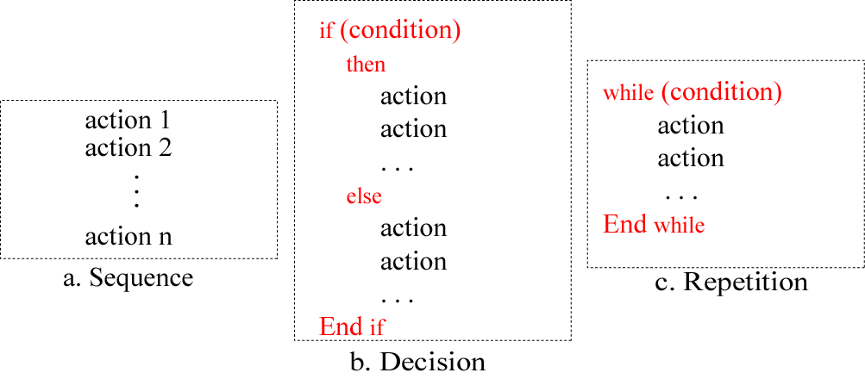
Figure 8-8
Pseudocode for three constructs

Slide 15
Example 1
Write an algorithm in pseudocode that finds the average of two numbers
Solution
See Algorithm 8.1 on the next slide.

Slide 16
Algorithm 8.1:
Average of two
AverageOfTwo
Input: Two numbers
Add the two numbers
Divide the result by 2
Return the result by step 2
End

Slide 17
Example 2
Write an algorithm to change a numeric grade to a pass/no pass grade.
Solution
See Algorithm 8.2 on the next slide.

Slide 18
Algorithm 8.2:
Pass/no pass Grade
Pass/NoPassGrade
Input: One number
if (the number is greater than or equal to 60)
then
  1.1 Set the grade to “pass”
  else
  1.2 Set the grade to “nopass”
  End if
Return the grade
End

Slide 19
Example 3
Write an algorithm to change a numeric grade to a letter grade.
Solution
See Algorithm 8.3 on the next slide.

Slide 20
Algorithm 8.3:
Letter grade
LetterGrade
Input: One number
1. if (the number is between 90 and 100, inclusive)
then
  1.1 Set the grade to “A”
  End if
2. if (the number is between 80 and 89, inclusive)
then
  2.1 Set the grade to “B”
  End if
Continues on the next slide

Slide 21
Algorithm 8.3:
Letter grade (continued)
3. if (the number is between 70 and 79, inclusive)
then
  3.1 Set the grade to “C”
  End if
4. if (the number is between 60 and 69, inclusive)
then
  4.1 Set the grade to “D”
  End if
Continues on the next slide

Slide 22
Algorithm 8.3:
Letter grade (continued)
5. If (the number is less than 60)
then
  5.1 Set the grade to “F”
  End if
6. Return the grade
  End

Slide 23
Example 4
Write an algorithm to find the largest of a set of numbers. You do not know the number of numbers.
Solution
See Algorithm 8.4 on the next slide.

Slide 24
Algorithm 8.4:
Find largest
FindLargest
Input: A list of positive integers
Set Largest to 0
while (more integers)
2.1 if (the integer is greater than Largest)
then
2.1.1 Set Largest to the value of the integer
End if
End while
Return Largest
End

Slide 25
Example 5
Write an algorithm to find the largest of 1000 numbers.
Solution
See Algorithm 8.5 on the next slide.

Slide 26
Algorithm 8.5:
Find largest of 1000 numbers
FindLargest
Input: 1000 positive integers
Set Largest to 0
Set Counter to 0
while (Counter less than 1000)
3.1 if (the integer is greater than Largest)
then
3.1.1 Set Largest to the value of the integer
End if
3.2 Increment Counter
End while
Return Largest
End

Slide 27
8.4
MORE FORMAL DEFINITION

Slide 28

Note:
Algorithm:An ordered set of unambiguous steps that produces a result and terminates in a finite time.

Slide 29
8.5
SUBALGORITHMS

Slide 30
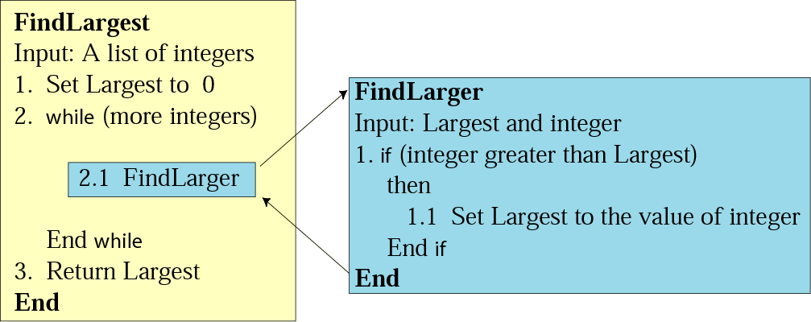
Figure 8-9
Concept of a subalgorithm

Slide 31
Algorithm 8.6:
Find largest
FindLargest
Input: A list of positive integers
Set Largest to 0
while (more integers)
2.1 FindLarger
End while
Return Largest
End

Slide 32
Subalgorithm:
Find larger
FindLarger
Input: Largest and current integer
if (the integer is greater than Largest)
then
1.1 Set Largest to the value of the integer
End if
End

Slide 33
8.6
BASIC
ALGORITHMS

Slide 34
summation：求和
product：乘积
Smallest and largest：最大和最小
Sorting：排序
  Selection sort：选择排序
  Bubble sort：冒泡排序
  Insertion sort：插入排序
Searching：查找
  Sequential search：顺序查找
  binary search：折半查找

Slide 35
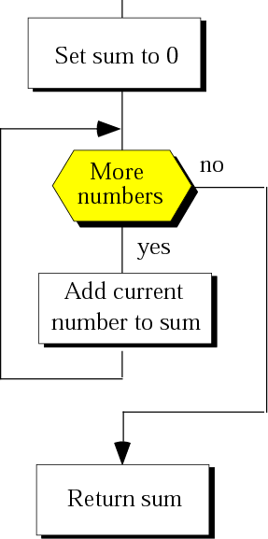
Figure 8-10
Summation
Three Part:
(1)Initialization
(2)Iteration
(3)Return

Slide 36
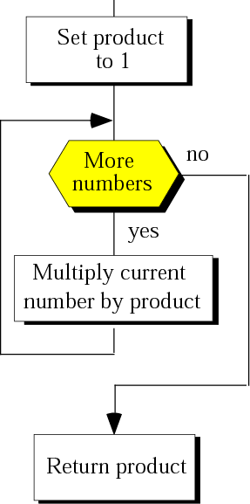
Figure 8-11
Product

Slide 37
Figure 8-11
Sorting
1.Why sorting?
2. Sorting
Selection Sort
Bubble Sort
Insertion Sort
3. Other Sorting:
Quick Sort
Heap Sort
Shell Sort
Bucket Sort
Merge Sort
…

Slide 38
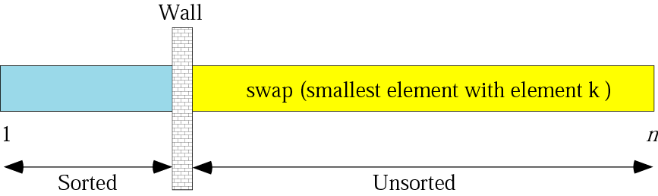
Figure 8-12
Selection sort
交换（第k个最小元素）

Slide 39
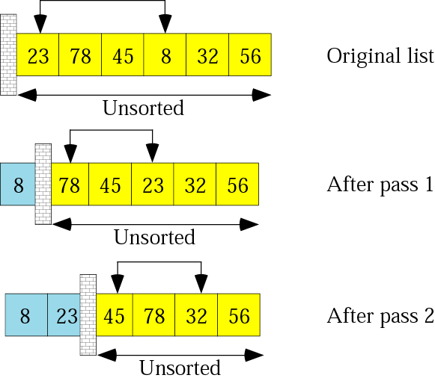
Figure 8-13: part I
Example of selection sort

Slide 40
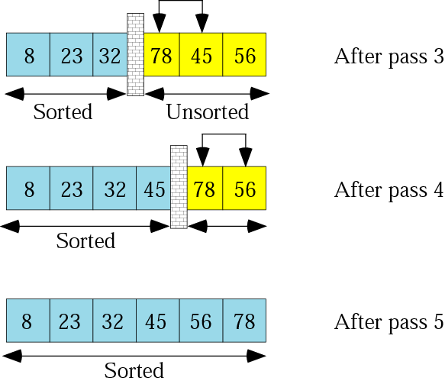
Figure 8-13: part II
Example of selection sort

Slide 41
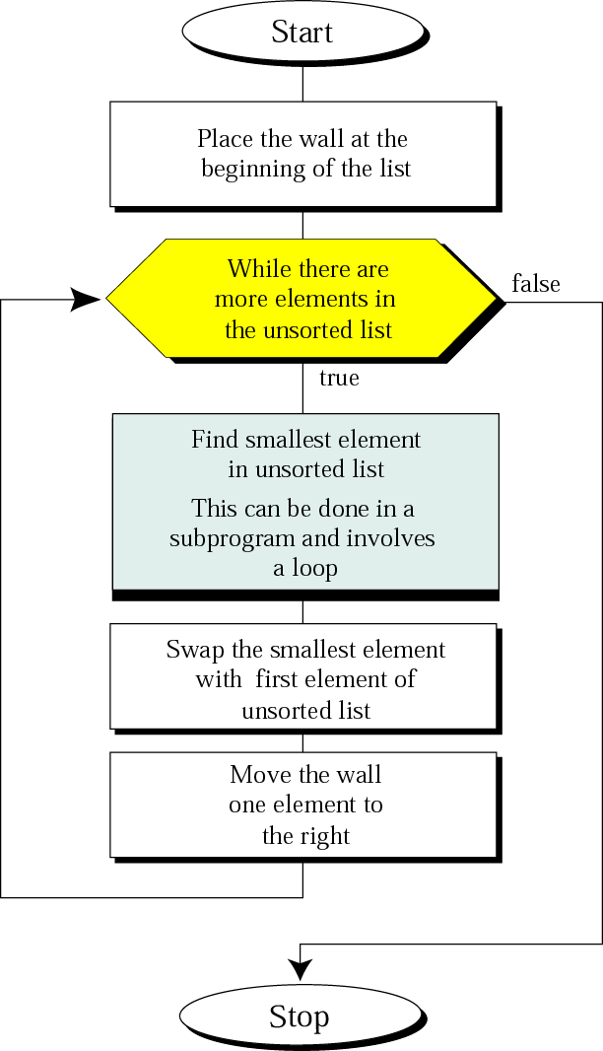
Figure 8-14
Selection sort
algorithm

Slide 42
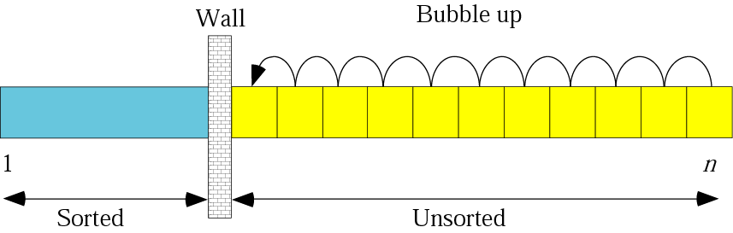
Figure 8-15
Bubble sort

Slide 43
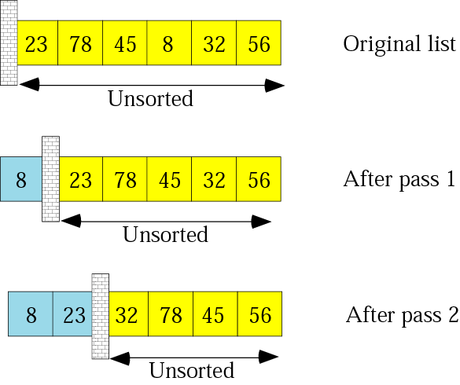
Figure 8-16: part I
Example of bubble sort

Slide 44
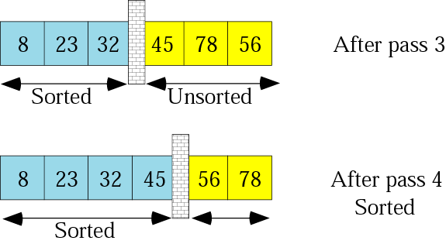
Figure 8-16: part II
Example of bubble sort

Slide 45
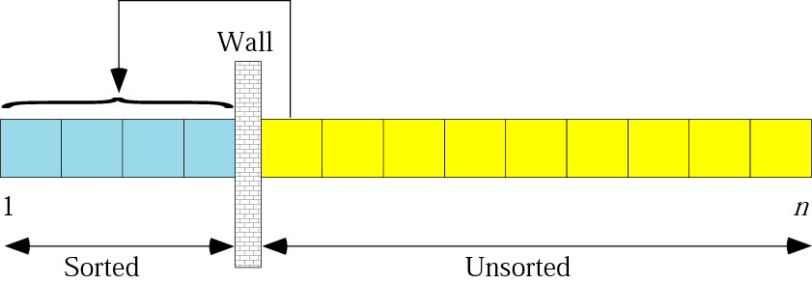
Figure 8-17
Insertion sort

Slide 46
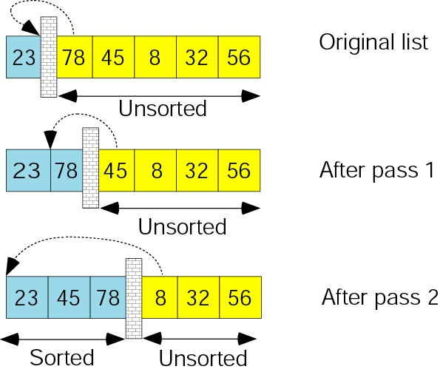
Figure 8-18: part I
Example of insertion sort

Slide 47
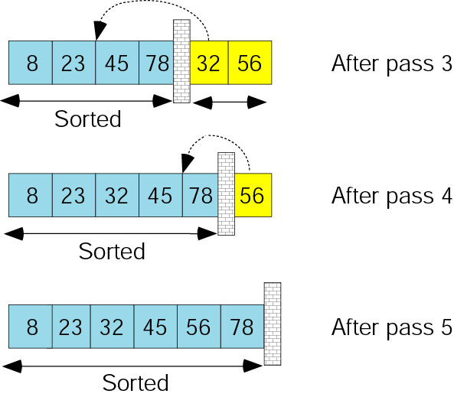
Figure 8-18: part II
Example of insertion sort

Slide 48
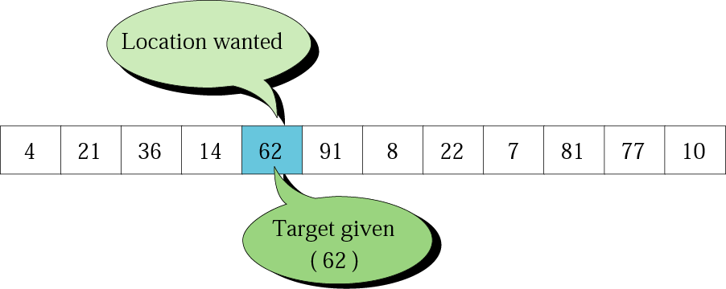
Figure 8-19
Search concept

Slide 49
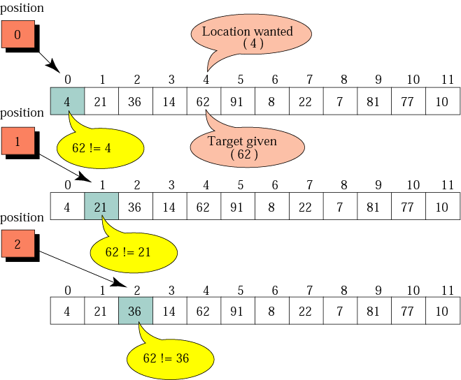
Figure 8-20: Part I
Sequential Search

Slide 50
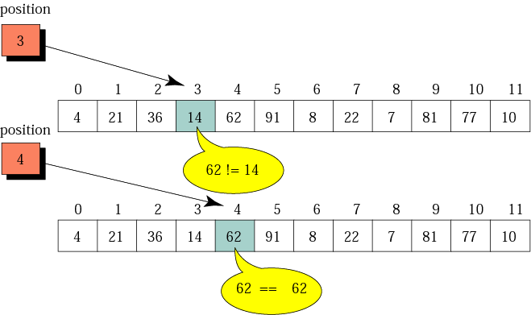
Figure 8-20: Part II
Example of a sequential Search

Slide 51
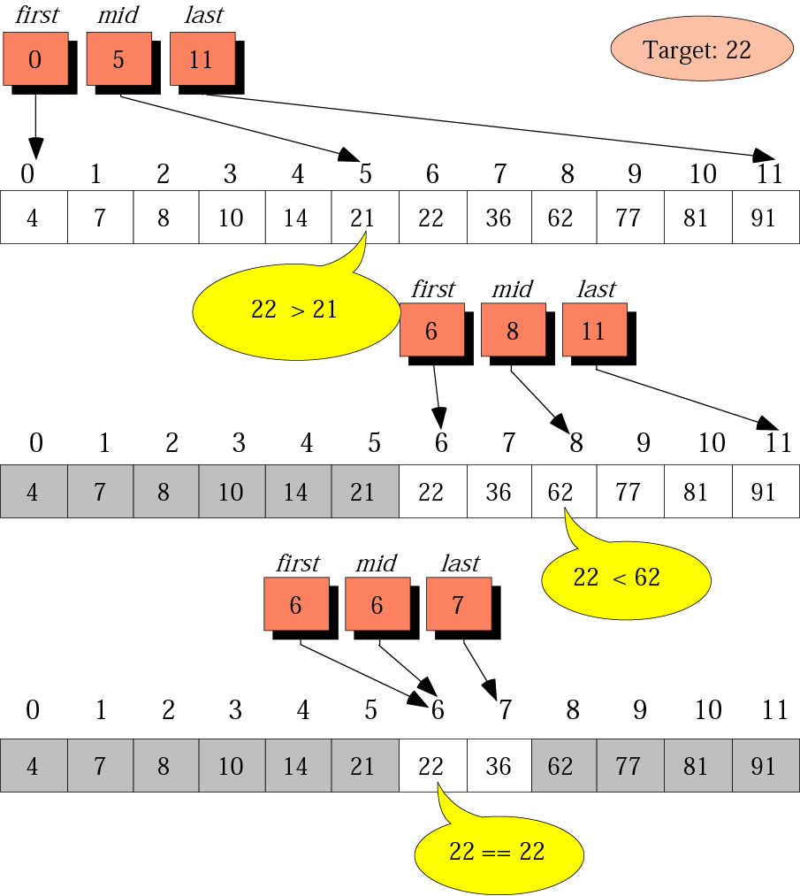
Figure 8-21
Example of a binary search

Slide 52
8.7
RECURSION

Slide 53
Iterative：迭代
recursion：递归。算法自我调用。
Factorial:阶乘

Slide 54
There are two methods for solving a problem:
Iteration
Recursion

Slide 55
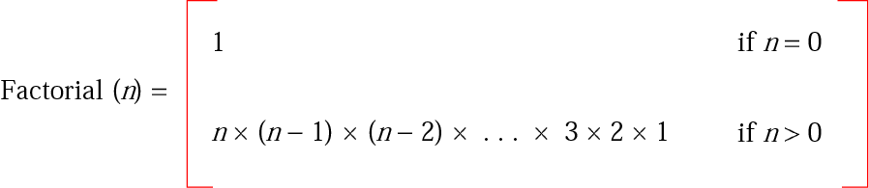
Figure 8-22
Iterative definition of factorial

Slide 56
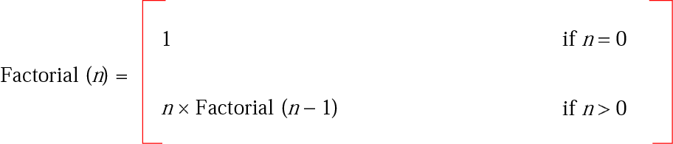
Figure 8-23
Recursive definition of factorial

Slide 57
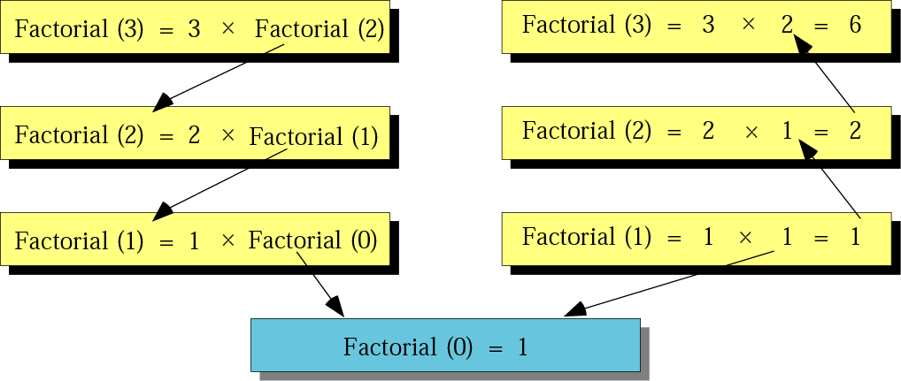
Figure 8-24
Tracing recursive solution to factorial problem

Slide 58
Algorithm 8.7:
Iterative factorial
Factorial
Input: A positive integer num
Set FN to 1
Set i to 1
while (i is less than or equal to num)
3.1 Set FN to FN × i
3.2 Increment i
End while
Return FN
End

Slide 59
Algorithm 8.8:
Recursive factorial
Factorial
Input: A positive integer num
if (num is equal to 0)
then
1.1 return 1
else
1.2 return num × Factorial (num – 1)
End if
End

Slide 60
Summary
非正式地讲，算法(Algorithm)是一步一步解决问题或完成任务的方法。
• 算法接受一个输入数据的列表，生成一个输出数据的列表。

Slide 61
Summary
程序由顺序(sequence)、判断(decision)和循环(repetition)结构构成。
• 流程图（flowchart）是算法图形化的表示。
伪代码（ pseudocode ）是算法类似英语的表示。

Slide 62
Summary
算法正式定义为一组步骤明确的有序集合，它产生结果并在有限的时间内终止。
• 算法可分解为称为子算法 ( subalgorithm ) 的更小单元。

Slide 63
Summary
排序(sorting)是一种基本算法。常用的有选择排序(selection sort)、冒泡排序(bubble sort)、插入排序(insertion sort)。
查找(searching)是一种基本算法。常用的有顺序查找（用于无序表）、折半查找（用于有序表）。

Slide 64
Summary
迭代算法(iterative algorithm)只包括参数而不包括算法本身。
递归算法(recursive algorithm)包括算法本身。

Slide 65
Key terms
Algorithm:算法，是一种逐步解决问题或完成任务的方法。每个算法都有自己不同于其他算法的名字。
Informal definition：非正式定义
Input data ：输入数据
output data ：输出数据
Findlargest：取最大值。（一种算法的名字）
Refinement：精化
Generalization：普遍化（泛化）

Slide 66
Key terms
More formal definition:更正式的定义
1、Ordered set：有序集合。
2、unambiguous steps：明确步骤
3、produce a result：产生结果。
4、terminate in a finite time：在有限的时间内终止。

Slide 67
Key terms
subalgorithm：子算法。
subprogram：子程序
subroutine：子例程
procedure：过程
function：函数
method：方法
module：模块

